Slide 1




Setting Up Your Dashboard

Slide 2


Do This NOW ☺
Setting Up Your Email Account
To Engage With Seller and Buyers

Slide 3

Do This NOW ☺
Even If You Already Have A Gmail, Please Make Sure To Setup a NEW Gmail Account

Slide 4
Do This NOW ☺
Because…
We Don’t Want To Mix You Seller and Buyer Leads When Your “Engaging” Them

Slide 5

Do This NOW ☺
If This Doesn’t Make Sense Now… Don’t Worry! It Will All Come Together In The Next Module

Slide 6
Do This NOW ☺
WE WILL USE GOOGLE CHROME FOR OUR BROWSER. CERTAIN PLUGINS ONLY WORK WITH CHROME.
www.google.com/chrome

Slide 7
STEP #1
Go To The Link Below And Set Up A New Gmail Account:
www.accounts.google.com/SignUp

Slide 8
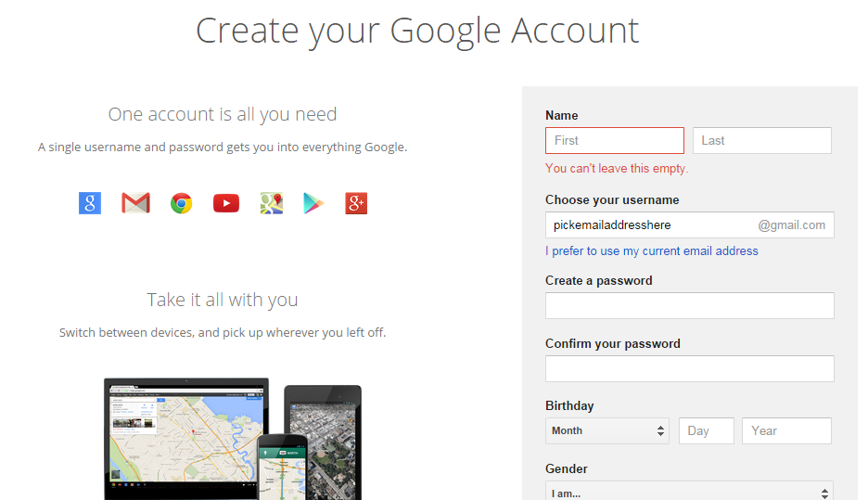

Slide 9
STEP #2
ENABLE CANNED RESPONSES ON YOUR GMAIL ACCOUNT
It’s Under Setting => Labs

Slide 10
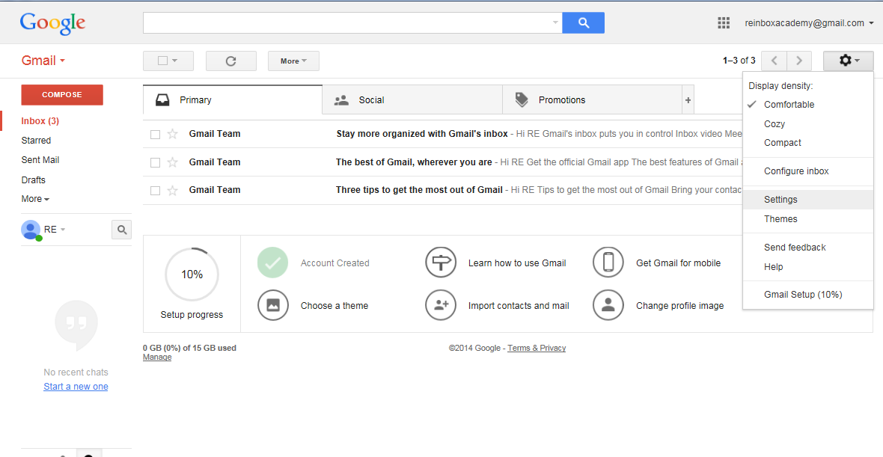

Slide 11
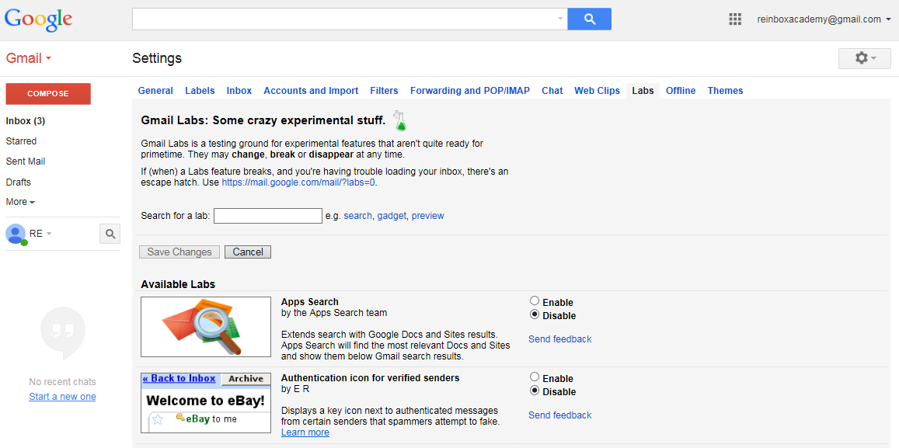

Slide 12
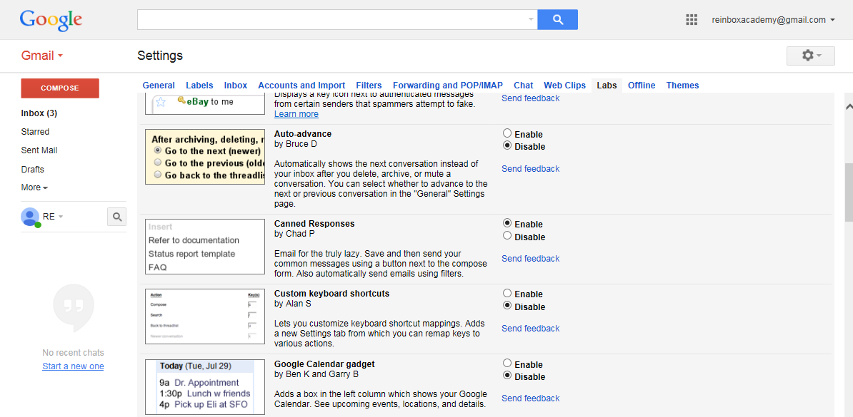
Make Sure to “Save Setting”

Slide 13
STEP #3
CHANGE DISPLAY TO 100 EMAILS
(When You Reply To The Leads at Scale,
You Want to See All Of Your Leads At Once)
It’s Under Setting => General

Slide 14
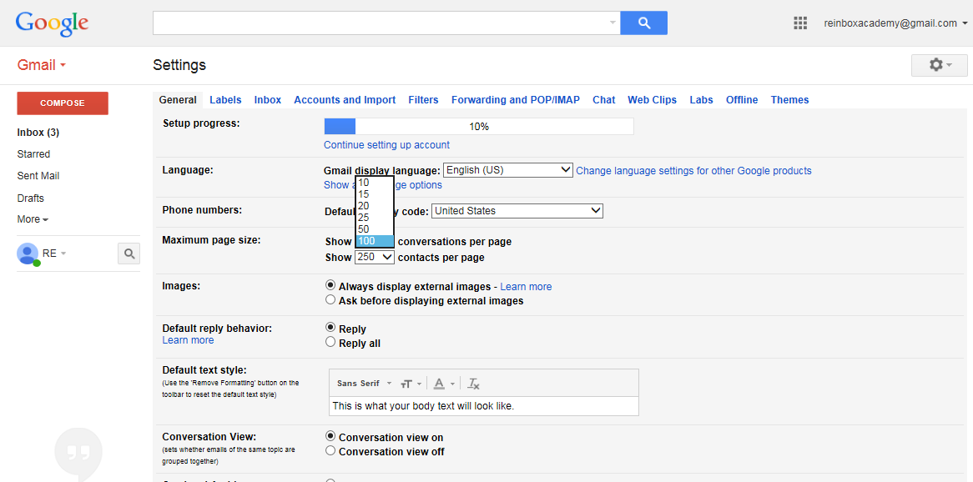
Make Sure to “Save Setting”

Slide 15
STEP #4
ADD YOUR SIGNATURE
(USE YOUR REGULAR SIGNATURE FOR NOW)
It’s Under Setting => General

Slide 16
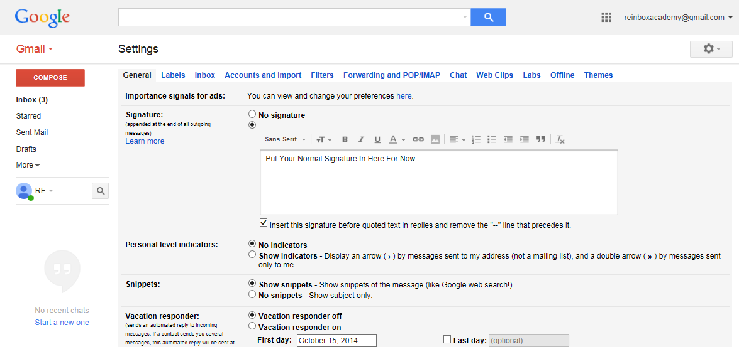
Make Sure to “Save Setting”

Slide 17

STEP #5
INSTALL RAPPORTIVE TO GMAIL
www.rapportive.com

Slide 18
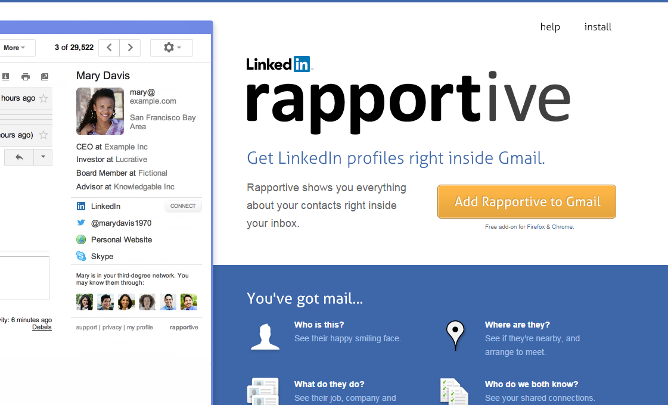

Slide 19
STEP #6
INSTALL RAPPORTIVE TO GMAIL
www.rapportive.com

Slide 20
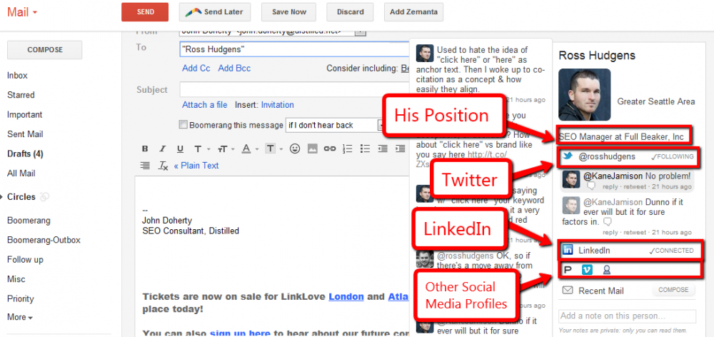

Slide 21
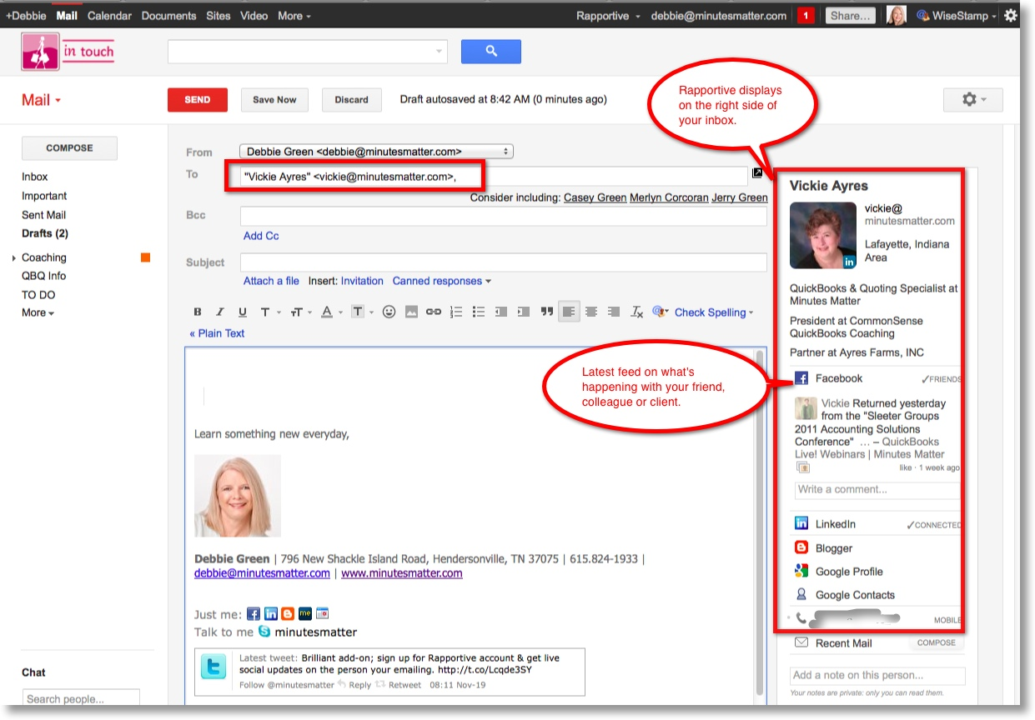

Slide 22
EXTRA CREDIT
UPDATE ALL OF YOUR SOCIAL MEDIA ACCOUNT WITH THIS NEW GMAIL ACCOUNT. FB AND LINKEDIN CAN HAVE MULTIPLE EMAILS.

